Slide 1

Catastrophe insurance (CI) policy foundations

Slide 2
Catastrophe insurance design challenge overview
Today – policy foundations
Next Thursday – CI design challenge
Why private markets struggle to insure catastrophes
Policy objectives governments must balance
Policy design levers used in catastrophe programs
Canadian context: earthquake, flood, and wildfire
Teams design a catastrophe insurance program for a specific peril
Industry professionals join to pressure-test proposals and provide industry perspectives
Teams compare approaches and defend trade-offs
Cross-peril discussion of policy choices

Slide 3
Learning objectives
Explain
Explain why private insurance markets struggle to insure catastrophic risks
Identify
Identify the key policy objectives governments must balance when designing catastrophe insurance programs
Describe
Describe the key policy levers used to structure catastrophe insurance programs
Evaluate
Evaluate how different design choices create trade-offs among competing catastrophe insurance policy objectives.

Slide 4
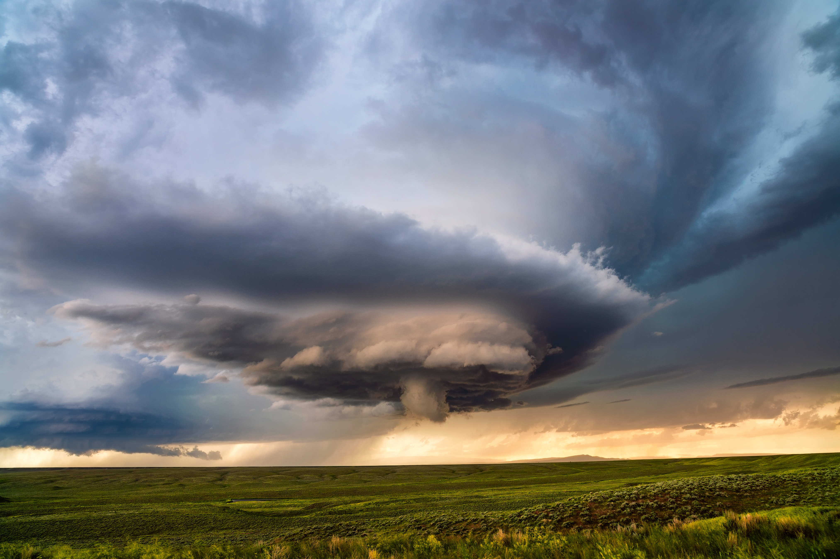
Why catastrophe insurance is different
Understanding the problem before designing the solution

Slide 5
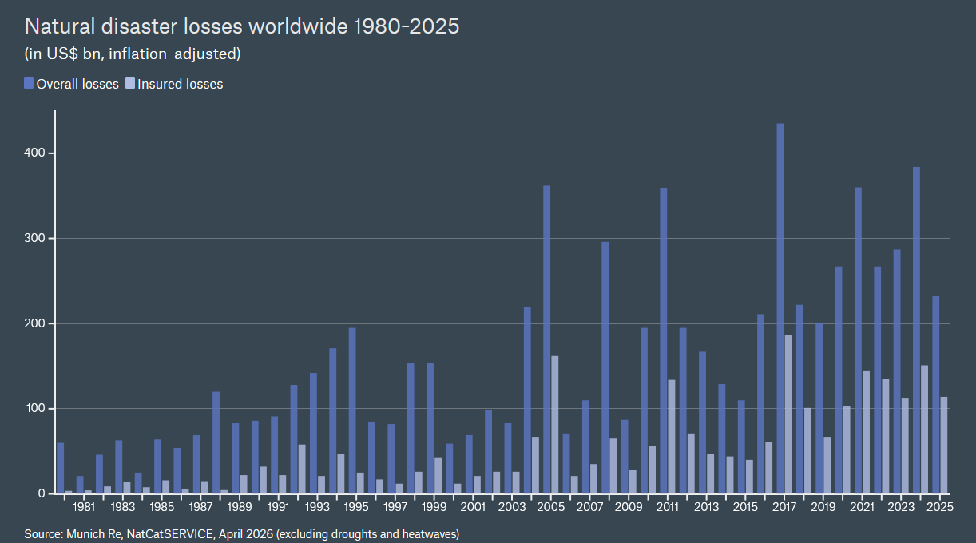
Global natural disaster losses
Catastrophe losses are increasing worldwide. This isn't just a Canadian problem. Governments around the world are facing the same challenge of financing increasingly costly disasters.

Slide 6
Loss drivers at play
Hazard
Increasing frequency and severity of secondary perils
Climate variability and warming trends
Vulnerability
Aging building stock
Exposure
Population growth in high-risk areas
Socio-economic effects
Construction cost inflation and supply chain disruption
Compounding events (storm + flooding, wildfire + wind)
Inadequate flood and wildfire mitigation
New risk features (solar panels, batteries)
Urban sprawl in wildfire and flood zones
Capital accumulation (higher-value homes and contents)
Litigation environment (in some jurisdictions)
Insurance market structure and regulation (affecting coverage and pricing)
Affordability pressures and underinsurance

Slide 7
Why catastrophe risks challenge private insurance markets
Losses are highly correlated
A single event can generate thousands of claims simultaneously
Risk cannot be diversified within a region
Loss distributions are fat-tailed
Rare events produce extremely large losses
Extreme losses dominate total losses
Extreme losses require large capital
Insurers must hold capital to survive rare but severe events
Capital tied to low-probability risks is expensive
Tail risk can threaten insurer solvency
Tail risk refers to the possibility of extremely rare but exceptionally large losses.
Reinsurance capacity may be limited during large events
Extreme catastrophe losses may exceed available industry capital

Slide 8
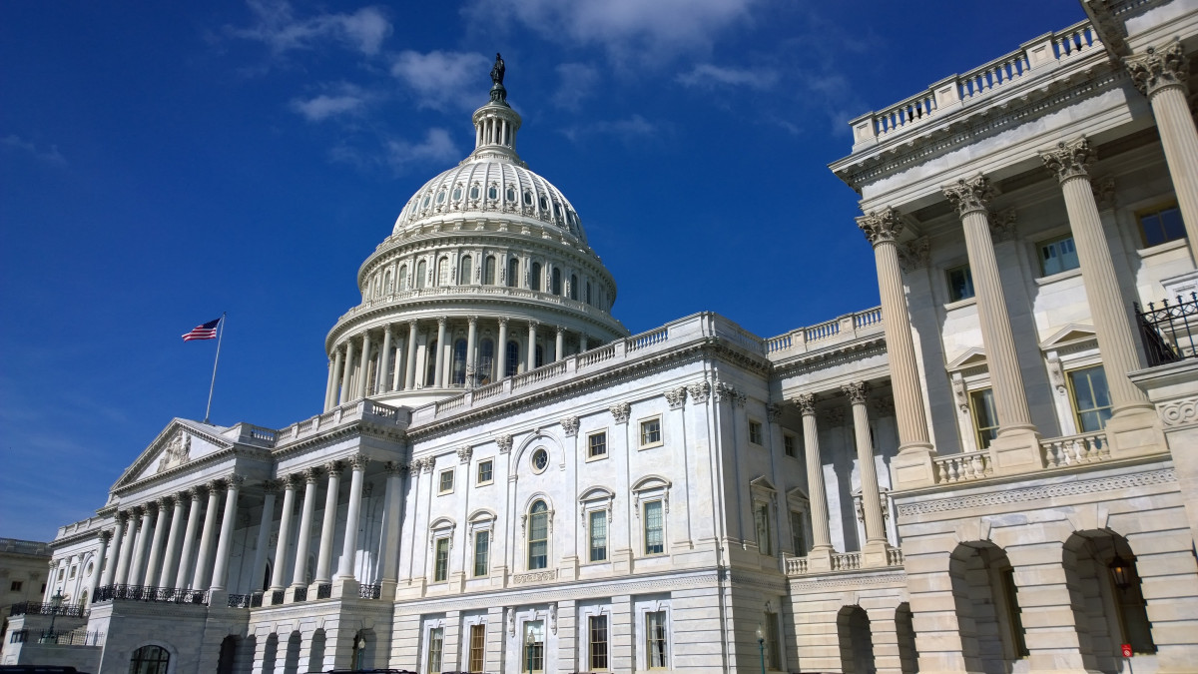
Designing catastrophe insurance programs
How governments respond to catastrophe risk

Slide 9
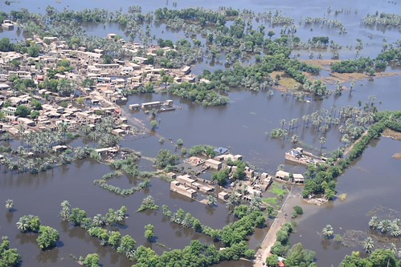
Learning from global CI programs
We examined more than 20 catastrophe insurance programs across 17 jurisdictions
Programs address a range of hazards, including:
  Flood
  Earthquake
  Windstorm / hurricane
  Wildfire
  Terrorism
These programs vary widely in how risks are shared among:
  Households
  Insurers
  Reinsurers
  Governments
Despite their differences, these programs use many of the same policy design levers.

Slide 10

CI program policy goals
Affordability: Insurance premiums remain within reach for households and businesses, including those in higher-risk areas
Availability: Coverage is widely offered so that most properties can obtain catastrophe insurance
Equity / fairness: The distribution of costs and benefits across policyholders and taxpayers is viewed as fair
Resilience: This includes both economic recovery and the continued functioning and stability of insurance markets
Reducing the protection gap: A larger share of catastrophe losses is covered by insurance rather than borne by households or governments
Solvency: Insurers and the system remain able to pay claims after very large disasters
Sustainability: The program remains financially and politically viable over time
This Photo by Unknown Author is licensed under CC BY

Slide 11
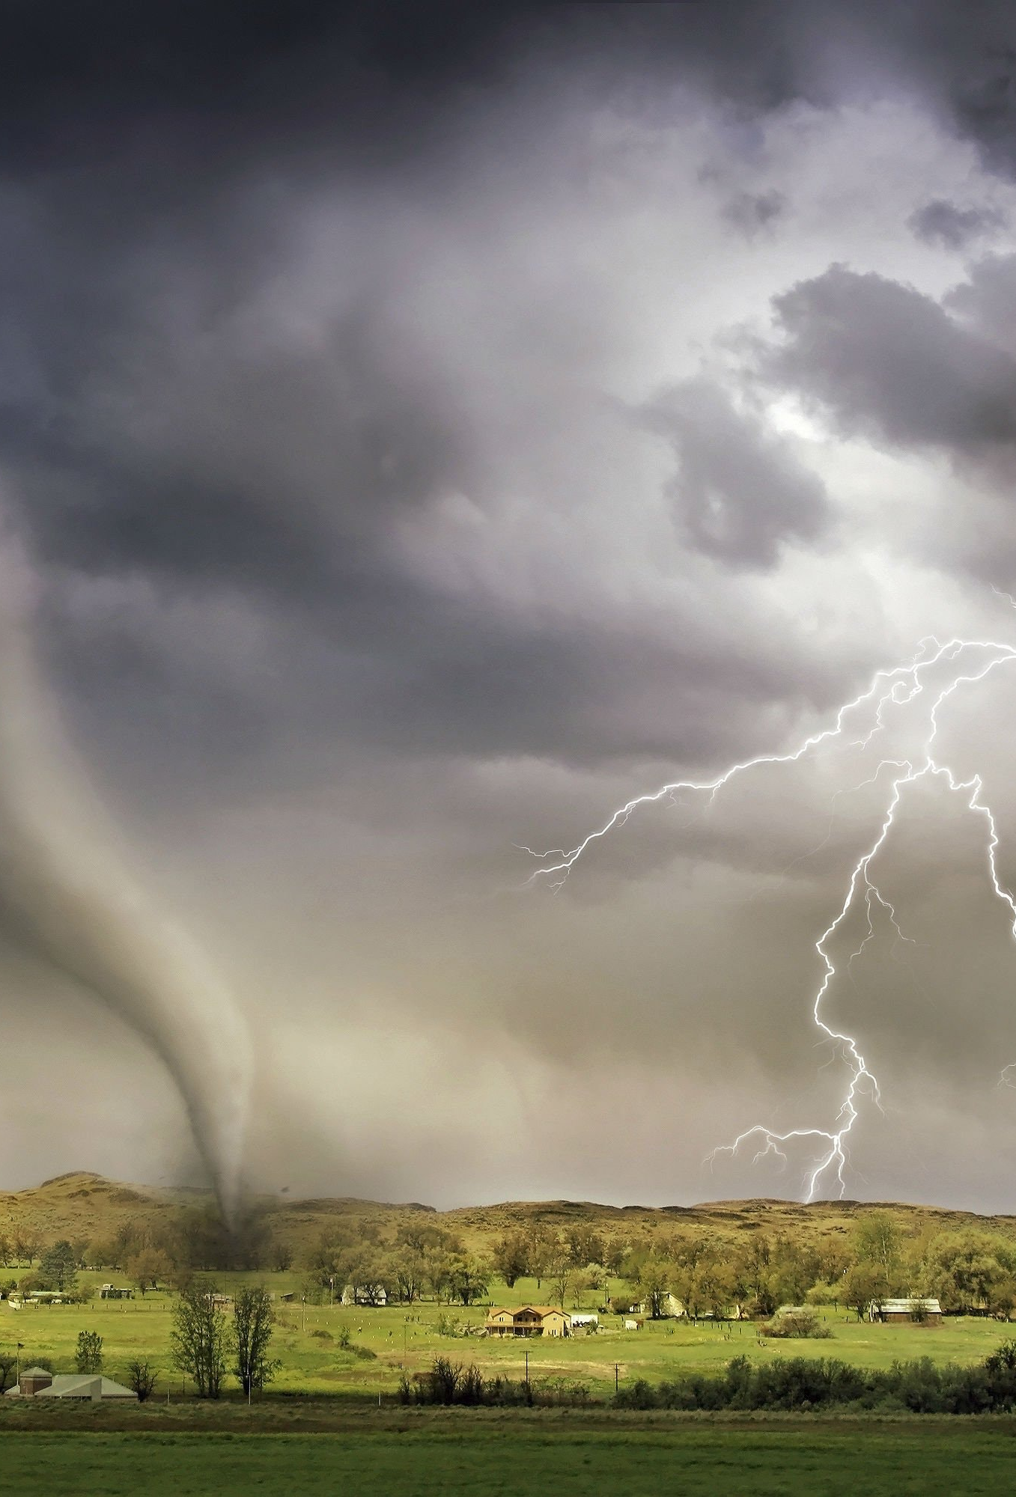
How the nature of the peril shapes CI program design
How the insurance industry typically treats the peril
  Included in standard property policy
  Covered through an endorsement
  Or typically excluded
Potential losses relative to available financial capacity of
  The domestic economy
  The primary insurance market
  Global reinsurance capacity
Return period of peak peril
  How frequently catastrophic events occur
  How quickly capital must be replenished
Insurability trends
  Climate trends may undermine long-term insurability

Slide 12
The six categories that structure catastrophe insurance programs
Coverage scope & participation
What perils and properties are covered? Are insurers required to offer coverage? Are policyholders required to purchase it?
Pricing & cross-subsidization
Are premiums risk-based or subsidized? How is risk shared across policyholders?
Capitalization & funding
How is the program initially capitalized and how are future losses financed?
Pooling & governance
How is catastrophe risk organized across the insurance market? Are program rules national or regional?
Government role in the catastrophe risk stack
Where does the government participate in paying claims? Who pays for extreme losses?
Operational roles
Who prices, underwrites, and settles claims (public vs. private)?

Slide 13

Designing a catastrophe insurance program
As we work through the six design categories, keep one overarching question in mind:
What roles should the government ultimately play in the catastrophe insurance program?
Government may act as:
  Insurer
  Reinsurer
  Backstop
  Liquidity provider
  Regulator
By the end of this framework, you should be able to explain why a particular government role emerges from your design choices.

Slide 14
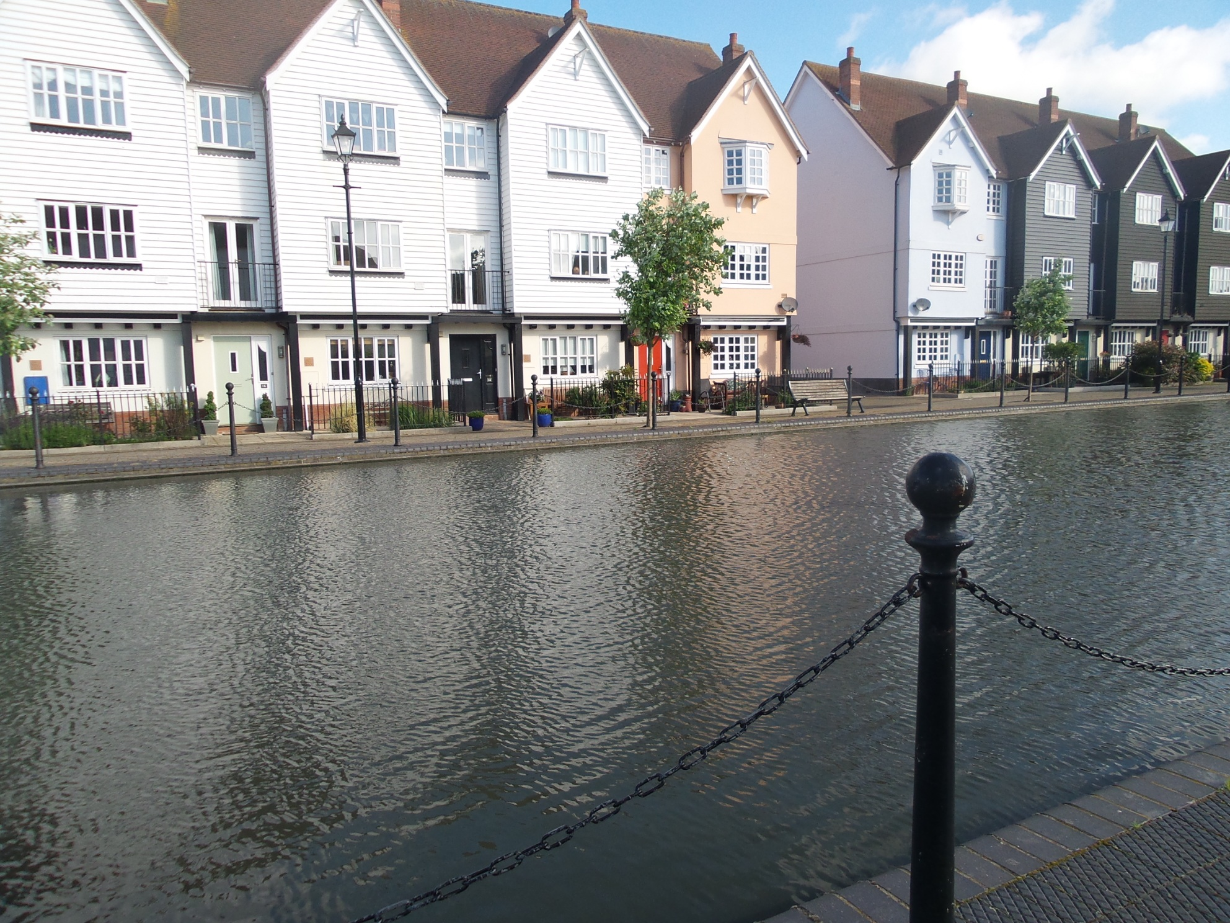
Key design choices: Coverage scope
What risks and properties are covered by the CI program?
Peril scope
  All catastrophic perils - Consorcio de Compensación de Seguros (CCS) (Spain); Belgian natural catastrophe regime
  Selected named perils only - Nat Cat (France)
  Single-peril program - California Earthquake Authority (CEA); Flood Re (United Kingdom); Pool Re (United Kingdom),
Eligible property types
  Residential property only - Toka Tū Ake / Natural Hazards Commission (Toka Tū Ake EQC) (New Zealand); Flood Re
  Residential property and commercial property - CCS; Natural Catastrophe Insurance of Iceland (NTÍ)
  Residential property, commercial property, and public infrastructure – very rare
Coverage structure
  Included automatically in standard property policy
  Offered as separate coverage or endorsement – National Flood Insurance Program (U.S.), CEA

Slide 15
Key design choices: Participation rules
Who must offer and who must purchase coverage?
Design decision | Mandatory | Voluntary
Insurer participation in CI program | All eligible insurers must participate | Insurers choose whether to participate in the program
Coverage offer | Insurers must offer catastrophe coverage | Insurers may choose to offer catastrophe coverage
Policyholder purchase | Property owners are required to purchase catastrophe coverage | Property owners choose whether to purchase coverage
Examples:
ARPC Cyclone Reinsurance Pool (Australia) – Mandatory participation, mandatory offer, voluntary purchase
CEA – Voluntary participation, mandatory offer, voluntary purchase
Nat Cat – Voluntary participation, mandatory offer, mandatory purchase

Slide 16
Key design choices: Insurer participation
Should insurer participation in the catastrophe pool or public reinsurance program be mandatory or optional?
Mandatory participation
  All insurers writing property coverage must participate in the pool
  Ensures broad risk sharing and avoids adverse selection
  Toka Tū Ake EQC, ARPC Cyclone reinsurance pool
Optional participation
  Insurers may choose whether to cede risk to the pool or public reinsurance program
  Allows flexibility but may limit risk diversification
  Nat Cat, Flood Re, ARPC Terrorism reinsurance pool
Notes:
This lever is about whether insurers are required to participate in the program.
This is different from policyholder participation. Here, the question is whether insurers must participate in the catastrophe pool or public reinsurance program.
First — mandatory participation.
All insurers writing eligible property coverage must participate.
This promotes broad risk sharing across the market and helps avoid adverse selection by preventing insurers from opting out of the pool.
However, mandatory participation does not solve every problem. If the program covers many high-risk properties, those exposures are shared across all participating insurers, which can increase capital requirements and solvency pressure.
Second — optional participation.
Insurers decide whether to cede risk to the pool or public program.
This creates the potential for adverse selection, where insurers with higher-risk portfolios are more likely to participate. If insurers do not find the pricing or risk-sharing attractive, they may choose not to participate, limiting the program's effectiveness.
But optional participation can work.
Flood Re is a good example. Participation is voluntary, but the program is designed to make participation attractive through its pricing structure and the levy collected from all home insurers.
So the key question becomes:
How much risk sharing do you want, and what incentives are needed to encourage insurer participation?
The trade-off is:
Mandatory participation improves diversification and reduces adverse selection, but spreads catastrophe risk across all participating insurers.
Optional participation provides flexibility, but may require careful pricing, incentives, or subsidies to avoid adverse selection and maintain broad participation.

Slide 17

Key design choices: Pricing
How closely should premiums reflect underlying catastrophe risk?
Risk-based pricing
  Premiums reflect expected catastrophe losses and exposure
  Premiums vary by location and property risk characteristics
  CEA; Turkish Catastrophe Insurance Pool (TCIP)
Key determinants of catastrophe premiums
  Expected catastrophe losses
  Reinsurance costs
  Regulatory capital requirements

Slide 18
Key design choices: Cross-subsidization
How should risk be shared across policyholders?
A catastrophe insurance program can be actuarially sound even if individual policyholders do not pay actuarially fair premiums.
Flat or nationally averaged premiums
  Similar premiums across regions despite different risk levels
  Nat Cat; Toka Tū Ake EQC
Implicit cross-subsidies
  High-risk areas supported by premiums from lower-risk areas
  Most CI programs
Policy choices
  Allow cross-subsidies within the insurance pool - Flood Re; Australian Cyclone Reinsurance Pool
  Cap premiums in high-risk areas - Flood Re; Citizens Property Insurance Corporation (Florida)
  Provide explicit government subsidies – Bureau de tarification – Catastrophes naturelles (BT-CN) (Belgium), NFIP
Trade-offs
  Weakening price signals may encourage development or exposure in high-risk areas
This Photo by Unknown Author is licensed under CC BY

Slide 19

Key design choices: Initial program capitalization
How should the CI program obtain its initial capital?
Government capital or disaster funds
  Provides immediate financial capacity
  Toka Tū Ake EQC; NTÍ
Insurer contributions
  Aligns insurer incentives with program sustainability
  CEA; Flood Re
No initial fund (post-event financing only)
  Relies entirely on post-event financing
  TRIP

Slide 20
Key design choices: Program funding
How should catastrophe losses be financed over time?
Pre-funded
  Premiums accumulate in a catastrophe reserve fund
  Funds are available immediately after a disaster
  Improves financial preparedness but higher premiums and accumulated funds may be politically difficult to protect over time
  Examples: Toka Tū Ake EQC; NTÍ, Flood Re
Post-event funded
  Funds raised after disasters occur
  May rely on assessments, borrowing, or taxpayer support
  May create fiscal risk
  TRIP; Belgian natural catastrophe regime
Hybrid
  Combination of pre-funded reserves, risk transfer, and post-event financing
  Potential balance of affordability and resilience
  Citizens; Florida Hurricane Catastrophe Fund (FHCF); ARPC Terrorism and Cyclone Reinsurance Pools

Slide 21
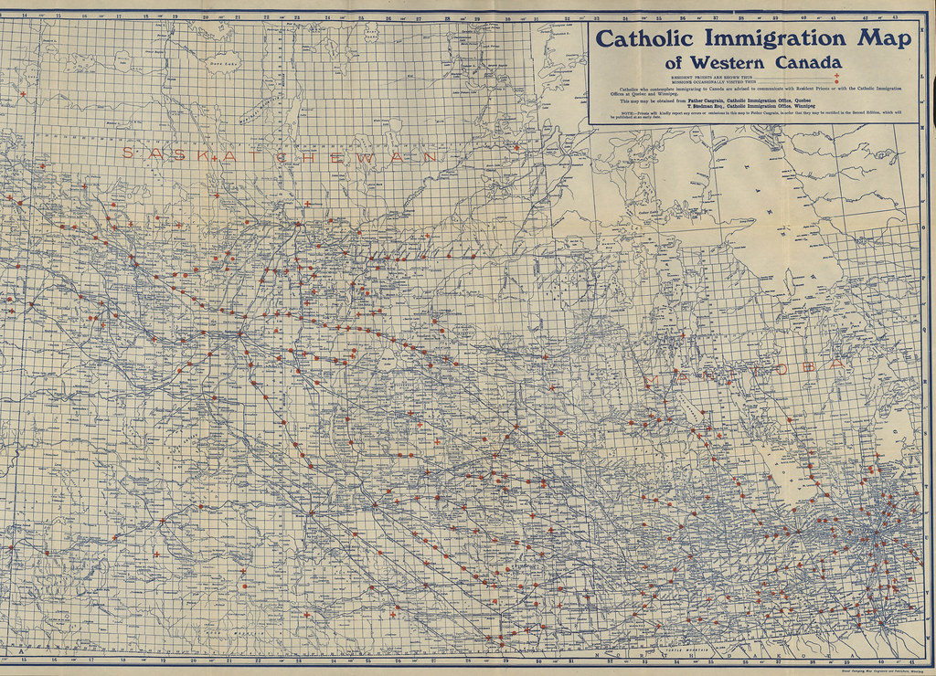
Key design choices: Market structure
How should catastrophe risk be organized and shared across the insurance market?
National multi-peril pool
  Single pool covers multiple catastrophe hazards
  Risk is shared broadly across insurers and hazards
  Improves diversification but may increase cross-subsidization
  NNPP, Pool Against National Disasters (Romania)
Peril-specific pool
  Separate pool created for a specific hazard
  Other catastrophe risks remain outside the pool
  Targets specific risks but reduces diversification
  ARPC Cyclone and Terrorism Reinsurance Pools, Pool Re, Nederlandse Herverzekeringsmaatschappij voor Terrorismeschaden
Limited pooling / decentralized market
  Primary insurers retain underwriting and claims responsibility
  Risk is transferred through optional reinsurance, capital markets or government support mechanisms
  Maintains decentralized market structure while limiting formal risk sharing
  Belgian natural catastrophe regime, Nat Cat

Slide 22
Key design choices: Governance
Should catastrophe insurance be designed nationally or regionally?
National framework
  Common coverage, eligibility, and program rules
  Consistent consumer experience across the country
  Greater simplicity but less regional flexibility
  UK, France, Australia
Regional or decentralized framework
  Rules vary across jurisdictions or insurers
  Coverage and pricing reflect local conditions and regulatory choices
  Greater flexibility but less consistency
  Switzerland, U.S.

Slide 23


Key design choices: Government role in the catastrophe risk stack
How far into the catastrophe risk stack does government participation extend?
Early-layer participation
  Government directly insures an initial (primary) layer of losses
  Improves affordability and availability but increases public exposure and moral hazard
  Toka Tū Ake EQC; CEA
Middle-layer participation
  Government shares catastrophe risk alongside insurers or reinsurers
  Expands market capacity
  JER; Caisse Centrale de Réassurance (CCR) (France)
Top-layer participation
  Government acts as an excess-of-loss backstop for extreme events, absorbing losses above a threshold
  Preserves private markets, but may leave protection gaps
  Typically guarantees a public insurer or reinsurer
  New Zealand (Toka Tū Ake EQC); Australia (ARPC Cyclone Pool); France (CCR)

Slide 24
Two approaches of government participation in the catastrophe risk stack
Government in early loss layers
Government as backstop

Slide 25
Key design choices: Operational roles
Who performs the key insurance functions in the catastrophe program?
Catastrophe insurance programs do not need to replicate the traditional private insurance model. Pricing, underwriting, and claims management may be separated across different entities. Most programs rely on private insurers to sell and service policies, although Citizens, NTÍ, and INS are notable exceptions that operate as primary insurers.
Pricing
  Pricing set by a public entity – BT-CN; CEA; CCS; PAID; Toka Tū Ake EQC; Flood Re
  Pricing set by private insurers (sometimes subject to public constraints) – ARPC cyclone pool; TRIP; NNPP
  Public pricing can improve affordability but may weaken risk-based signals
Underwriting
  Risks underwritten by a public entity – CEA; Flood Re;
  Risks underwritten by private insurers – Toka Tū Ake EQC; CCS; ARPC terrorism and cyclone pools; TRIP; NNPP; Nat Cat; JER; PAID
  Risks underwritten through a shared arrangement – BT-CN
  Public underwriting can expand coverage but may crowd out private market participation
Claims management
  Claims handled by a public entity – CCS;
  Claims handled by private insurers – CEA; TRIP; Nat Cat; ARPC terrorism and cyclone pools; Flood Re; JER; NNPP; PAID
  Claims handled by a shared arrangement - Toka Tū Ake EQC (private insurers handle most claims)
  Shared claims administration can use existing insurer infrastructure but may lead to coordination problems and coverage disputes

Slide 26
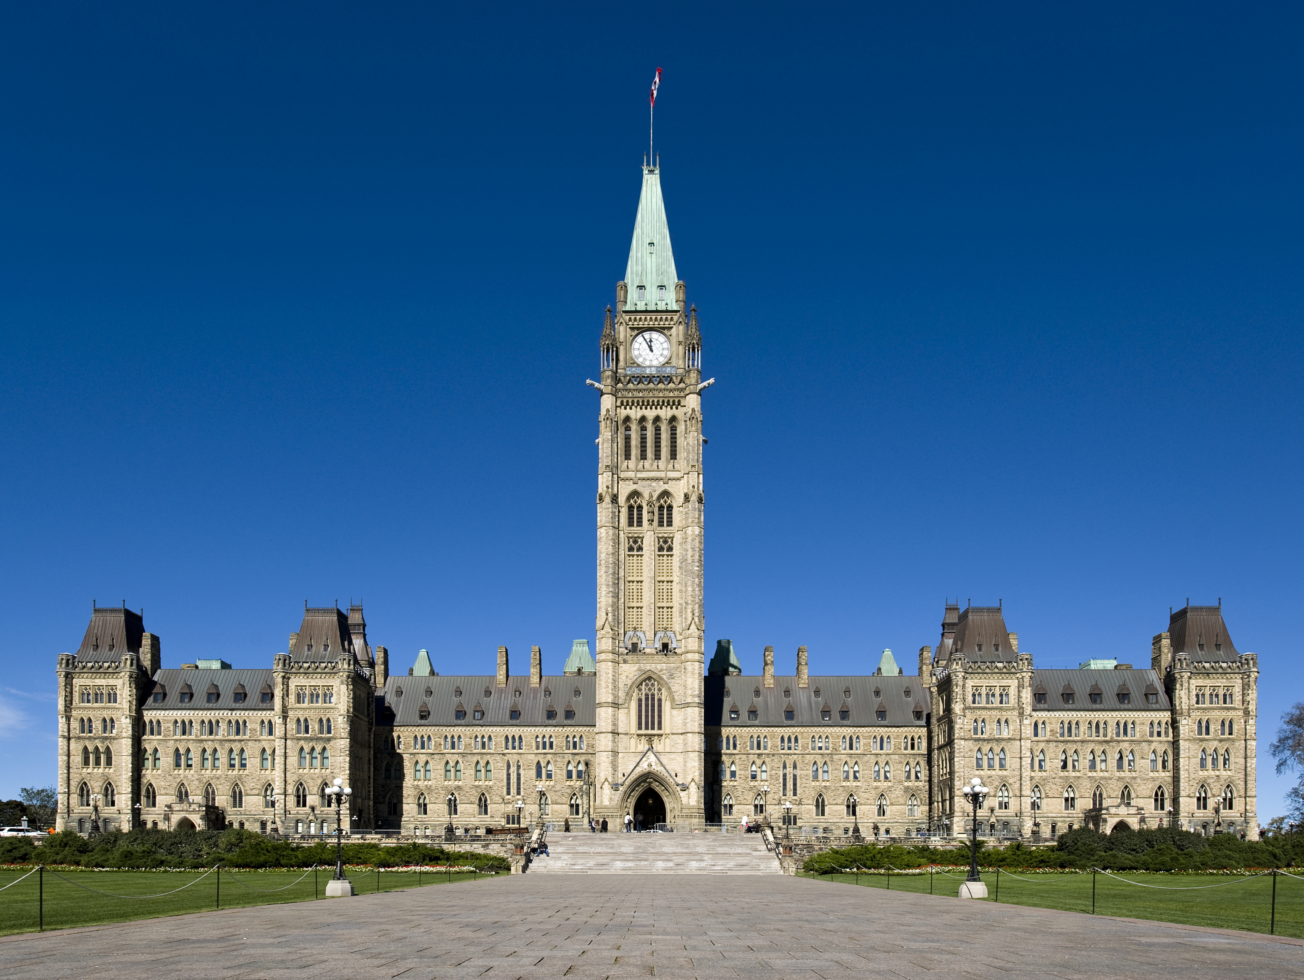
Government’s roles in the catastrophe insurance program
What roles does government ultimately play in delivering and financing catastrophe insurance?
The government's roles are often the outcome of earlier design choices. Participation, pricing, funding, pooling, operational roles, and the catastrophe risk stack together determine how directly government participates in the insurance program. A single catastrophe program may combine several of these roles.
Government as insurer
  Assumes the primary insurance obligation
  May retain or delegate pricing, underwriting, policy servicing, and claims management
  Provides the greatest direct government involvement
  Government as reinsurer
  Accepts catastrophe risk transferred from primary insurers
  Expands market capacity and supports insurer solvency
  Bears losses within the reinsurance layer
Government as regulator
  Establishes program rules, coverage requirements and insurer obligations
  Sets solvency standards and may influence market behaviour
Government as backstop
  Provides protection only for extreme losses above a specified threshold
  Supports insurers or reinsurers against catastrophic tail risk
  Participates only in most extreme catastrophe losses
Government as liquidity provider
  Provides immediate financing following catastrophic events
  Funding is expected to be recovered through future assessments, surcharges, or repayments
  Provides immediate claims-paying capacity without necessarily creating permanent public losses

Slide 27
Designing CI programs means managing trade-offs
Design choice | Key trade-off
Coverage scope & participation | Broader protection and risk pooling versus affordability, political feasibility, and moral hazard
Pricing & cross-subsidization | Risk-based incentives versus affordability and inclusion
Capitalization & funding | Financial resilience and transparency versus higher upfront costs or post-event uncertainty
Pooling & governance | Greater risk sharing and market stability versus complexity, regional equity, and local flexibility
Government role in the catastrophe risk stack | Greater public protection and market capacity versus taxpayer exposure and weaker private incentives
Operational roles | Public coordination and consistency versus private-sector expertise and efficiency
Every design choice carries implications
There is no universally "best" catastrophe insurance program. The most appropriate design depends on the objectives of the program and the trade-offs policymakers are willing to accept.

Slide 28
Using design levers to pursue program goals
Affordability
Availability
Equity / fairness
Resilience
Solvency
Sustainability
Reducing the protection gap
Possible policy objectives
Coverage scope & participation
Pricing & cross-subsidization
Program capitalization & funding
Pooling & governance
Government role in the catastrophe stack
Operational roles
Potential design levers
Different combinations of design levers advance different policy objectives and ultimately determine the role government plays in the catastrophe insurance program

Slide 29

Canada’s current approach
Understanding today’s catastrophe insurance architecture

Slide 30
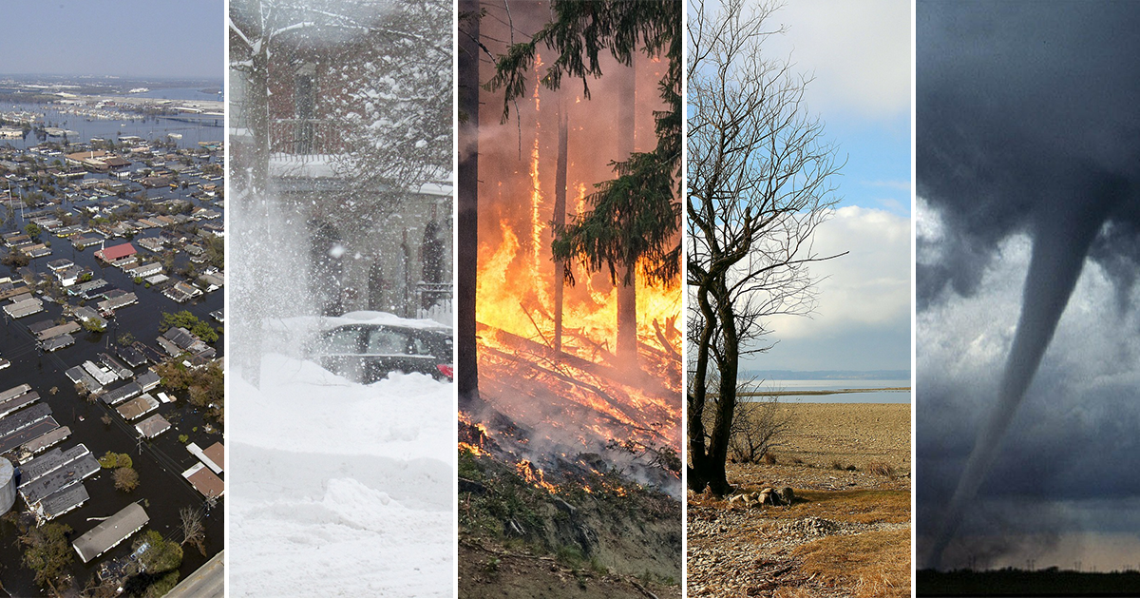
Canadian catastrophe insurance architecture
Canada manages catastrophe risk through a layered system rather than a national catastrophe insurance program
Households
Retain losses below deductibles, above limits and uninsured losses
Insurance may be unavailable or limited for some catastrophe risks
Private insurers
Provide residential property coverage
Bear primary underwriting risk
Reinsurers
Absorb large correlated catastrophe losses
Pricing influenced by global catastrophe losses
Federal Disaster Financial Assistance Arrangements (DFAA)
Provides financial assistance to provinces after major disasters
Fiscal backstop rather than an insurance program

Slide 31
Insured catastrophe losses
1983 – 2025
Most losses in Canada are driven by secondary perils
Insured catastrophe losses in Canada have increased significantly over the past two decades
Several recent events have produced multi-billion dollar insured losses
Severe convective storms, flooding, and wildfire are increasingly important sources of losses
Source: CatIQ

Slide 32
Canadian catastrophe events 2025
Peril | Provinces affected | Number of events
Flood | BC, AB, SK, MB, ON, QC, NB, NS, NL | 6
Wildfire | AB, SK, MB, NL | 5
Severe convective storm | AB, QC, SK, MB | 3
Winter weather | BC, AB, ON, QC, NB, NS, NL | 3
Windstorm | ON, QC | 1
Source: CatIQ

Slide 33
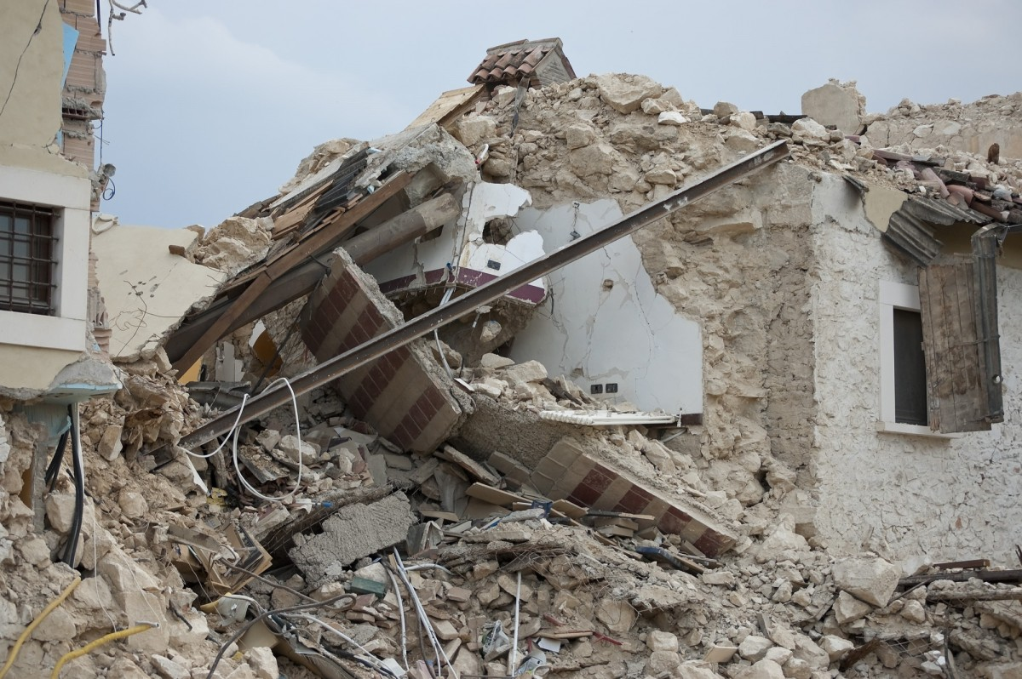
Earthquake risk in Canada
Earthquakes are low-frequency but potentially catastrophic events that can threaten the solvency of insurers.
Earthquake risk is concentrated in British Columbia and eastern Quebec.
Earthquake insurance is purchased as an optional endorsement to homeowners policies.
Take-up rates vary significantly across regions.
  Quebec: low take-up and limited awareness contribute to a large protection gap.
  British Columbia: higher take-up creates highly concentrated insurer exposure.
Even insured households may face significant uninsured losses.
  High deductibles and exclusions for secondary perils (e.g., landslide, tsunami).
  Fire-following losses and event definitions can create coverage ambiguity.
Designing earthquake insurance requires balancing tail-risk management, affordability, and protection gap reduction.

Slide 34
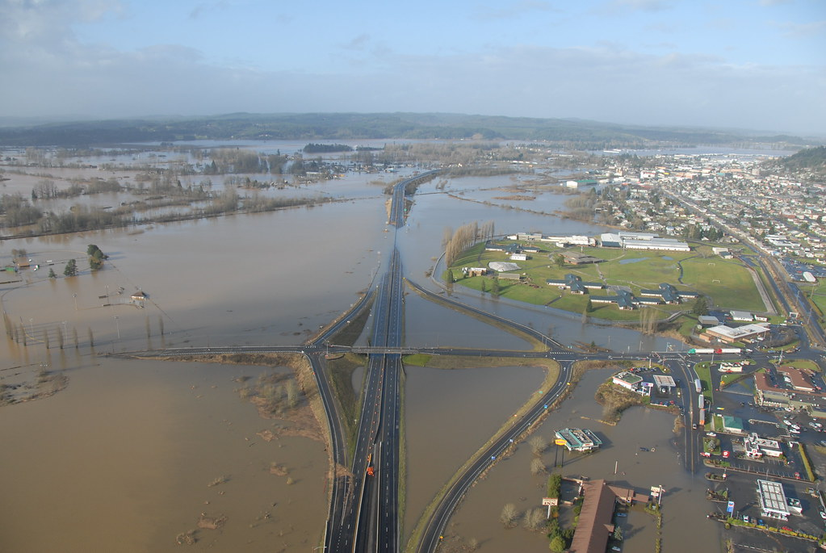
Flood risk in Canada
Flooding is the most frequent and costly natural disaster in Canada
Flood risk arises from river flooding, urban stormwater flooding, and coastal flooding
Overland residential flood insurance was introduced only in 2015, and remains difficult to obtain for many high-risk properties
Climate change and continued development in flood-prone areas are increasing both the frequency of losses and the value of exposed property
Many high-risk households remain uninsured or underinsured, creating a significant protection gap
Designing flood insurance requires balancing affordability, availability, risk-based pricing and protection gap reduction

Slide 35
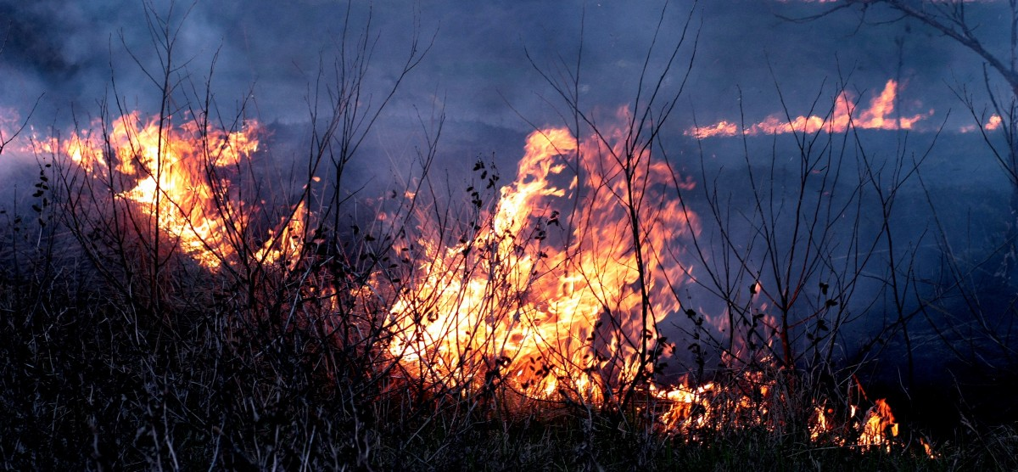
Wildfire risk in Canada
Wildfires have become more frequent and severe in recent years
Risk is concentrated in the wildland–urban interface (WUI), where development meets forested land
Wildfire losses are covered under standard property insurance policies
Large correlated events can generate significant accumulation risk for insurers
Some insurers have begun restricting new business or increasing premiums in high-risk areas
Wildfire is a natural and ecologically important process, creating policy trade-offs around suppression, mitigation, and development
Designing wildfire insurance requires balancing insurance availability, affordability, and incentives for risk reduction

Slide 36

Your turn
Your team will design a catastrophe insurance program for one of three Canadian perils

Slide 37
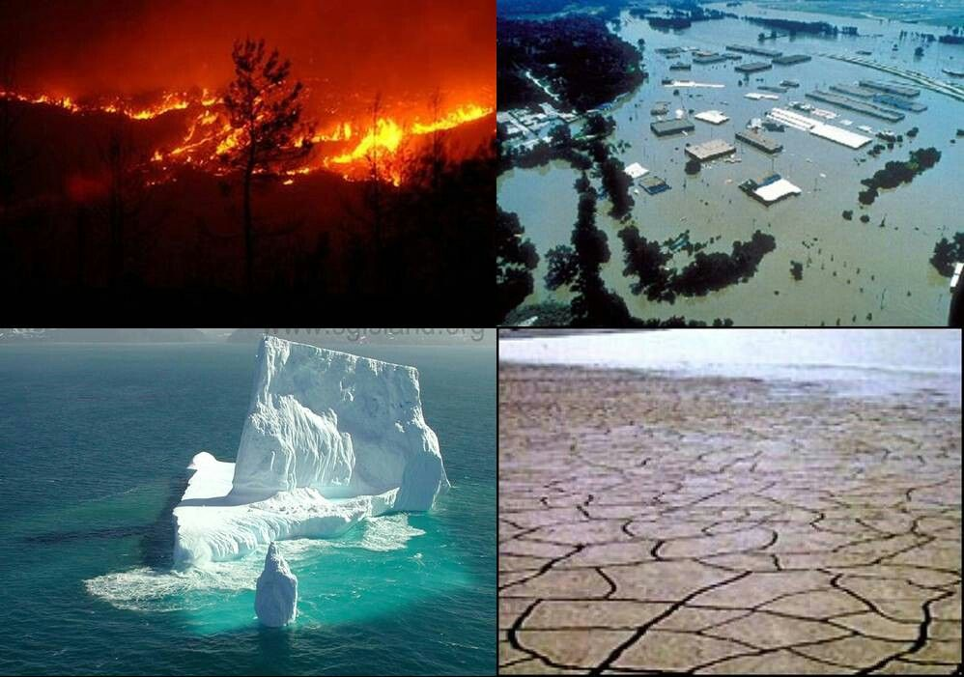
Next Thursday: Catastrophe insurance design challenge
Each team will design a catastrophe insurance program for one assigned peril – earthquake, flood or wildfire
Welcome and overview (15 minutes)
Team program design (45 minutes)
  Develop a catastrophe insurance program around peril characteristics and chosen policy objectives
Pair exchange (30 minutes)
  Compare designs, challenge assumptions, and explore key trade-offs with another team working on the same peril
Break (15 minutes)
Pair presentation preparation (20 minutes)
  Complete a shared synthesis of how the peril shaped the two program designs.
  Prepare a 5 minute presentation
Class presentations and discussion (35 minutes)
  Each pair presents its synthesis, followed by questions and discussion
Wrap-up (5 minutes)
Throughout the evening, insurance and reinsurance professionals will circulate during the exercise to test assumptions, challenge feasibility, and share industry perspectives

